Slide 1
Skeletal muscle tone regulation, Gamma system

Slide 2
MUSCLE TONE
State of partial isometric contraction maintained by continuous activity of alpha motor neurons.
Posture is maintained through reflex adjustments of tone of antigravity muscles.

Slide 3
PROPRIOCEPTORS-
MUSCLE SPINDLES
Polar ends
Central portion
Nuclear bag fibers
Nuclear chain fibers

Slide 4
MUSCLE SPINDLE RESPONSES
Static response
Involves Static nuclear bag and nuclear chain fibers
Via primary (Ia) and secondary (II) endinds
Dynamic response
Involves dynamic nuclear bag fibers
Via primary endings only

Slide 5
STRETCH REFLEX
Reflexive contraction following stretching

Slide 6
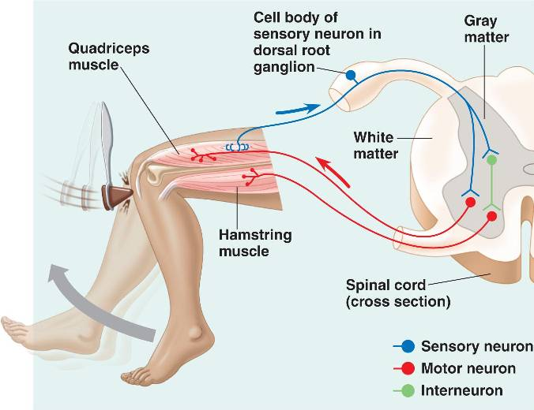
KNEE JERK
Upper motor neuron lesion
Hyperreflexia
Lower motor neuron lesion
Hyporeflexia

Slide 7
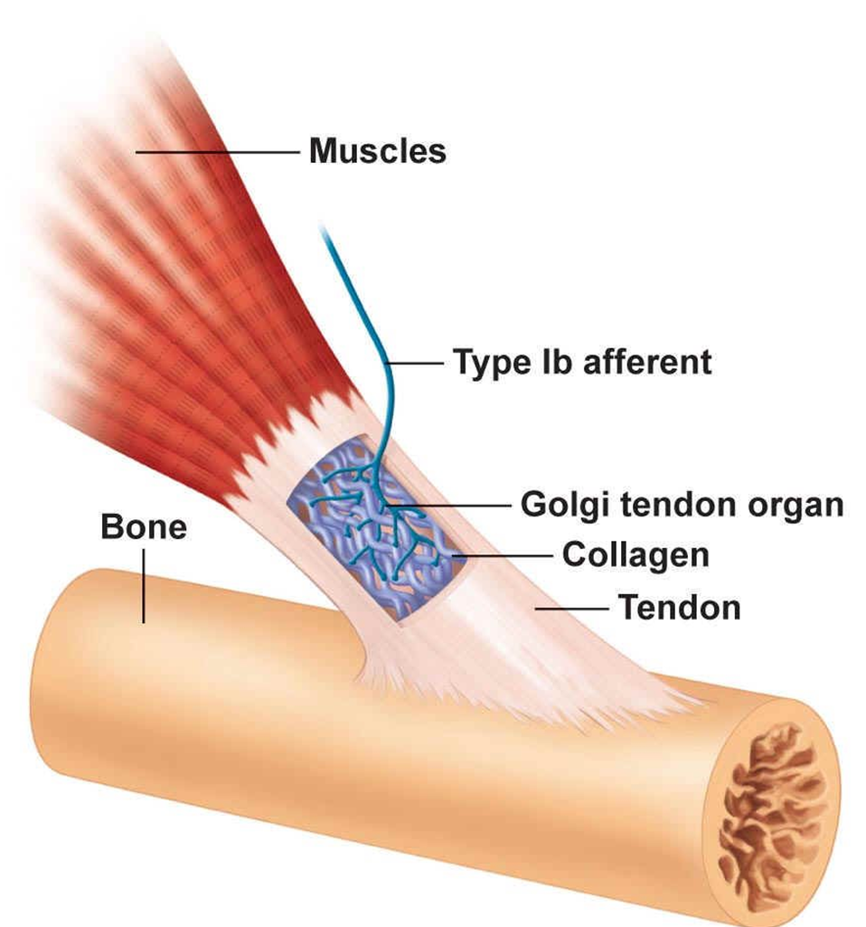
GOLGI TENDON ORGAN
Tension and change in tension
Autogenic inhibition/ inverse myotatic reflex

Slide 8
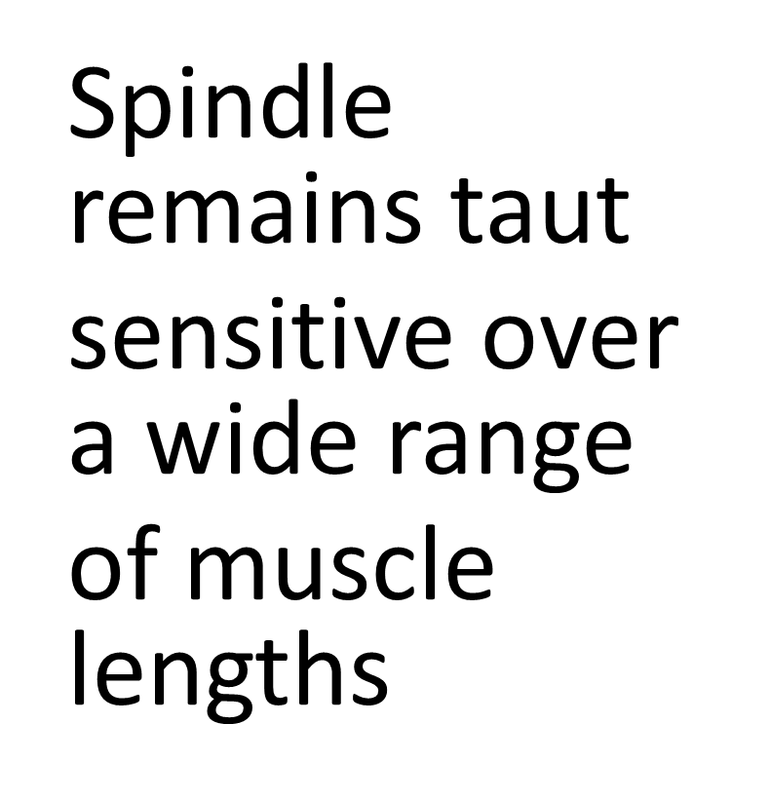
GAMMA NEURONS

Slide 9
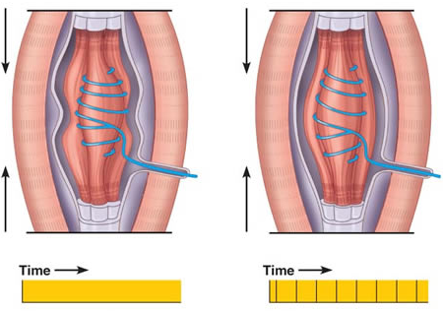
ALPHA GAMMA COACTIVATION

Slide 10
DAMPING FUNCTION
The myotatic reflex acts in the coarse adjustment of muscle tension
The fine adjustment in muscle activity are dependent on the integrity of the gamma loop.

Slide 11
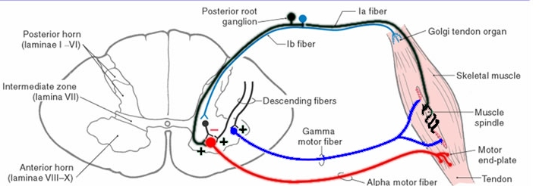
GAMMA LOOP-SPINDLE AS A DETECTOR
Signaling difference between the desired length of the muscle and its actual length.
If shorter than the actual length, the spindle afferents stimulate the motor neurons to generate a force that makes the muscle contract.

Slide 12
RETICULAR FORMATION
PONTINE RETICULAR SYSTEM/ FACILITATORY AREA
EXCITES ANTIGRAVITY MUSCLES IPSILATERALLY
MEDULLARY RETICULAR SYSTEM INHIBITS ANTIGRAVITY MUSCLES CONTRALATERALLY

Slide 13
VESTIBULAR SYSTEM
Vestibular nuclei control selectively the excitatory signals to the antigravity muscles via alpha and gamma motor neurons.
Maintain equilibrium by functioning in association with the pontine reticular nuclei via lateral and medial vestibulospinal tracts.

Slide 14


CEREBELLUM AS A COMPARATOR
Spinocerebellar tracts
Vermis
Fastigial nucleus
Reticular/vestibular nuclei

Slide 15
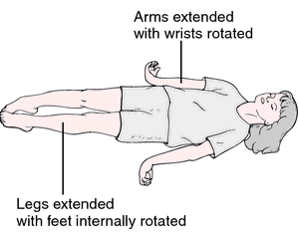
DECEREBRATE POSTURE
Low brain stem damage
Unopposed vestibulospinal firing, interrupted rubrospinal
Gamma motor neurons lack of inhibition

Slide 16
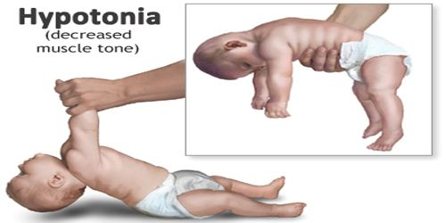
CEREBELLAR DISEASE
Hypotonia
Ataxia
Dysarthria

Slide 17
Sources:
Functional Neuroscience, Oswald Steward
Neuroscience, Sinauer Associates
Neurophysiology: A Conceptual Approach,Roger Carpenter, Benjamin Reddi
Physiology for undergraduate students, Indu Khurana
Fundamental Neuroscience: Michael J. Zigmond, Floyd E. Bloom Fifth edition
Guyton and Hall Textbook of Medical Physiology, 13th edition
Berne & Levy Physiology - 7th Edition
Ganong's Review of Medical Physiology, 24th Edition
Essentials of Medical Physiology. Seventh Edition

